Slide 1
Comp262 Group 3
Members:
Roland Joseph Baja
Christian Aduna
Lewis Merino

Slide 2
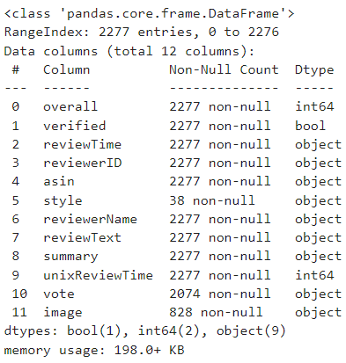
Dataset description
overall - Product Rating(int64)
verified - Product Verified(bool)
reviewTime - Time of the review(object)
reviewerID - ID of the reviewer(object)
asin- ID of the Product also known as Amazon Standard Identification Number(object)
style-style of the product(object)reviewer
Name- The name of the reviewer of the product(object)
reviewText- Review of the product(object)
summary- Summary of the review(object)
unixReviewTime-(int64 )vote - Votes if review is helpful or not (object)
image- Image from the user/reviewer(object)

Slide 3
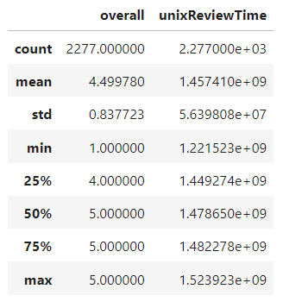
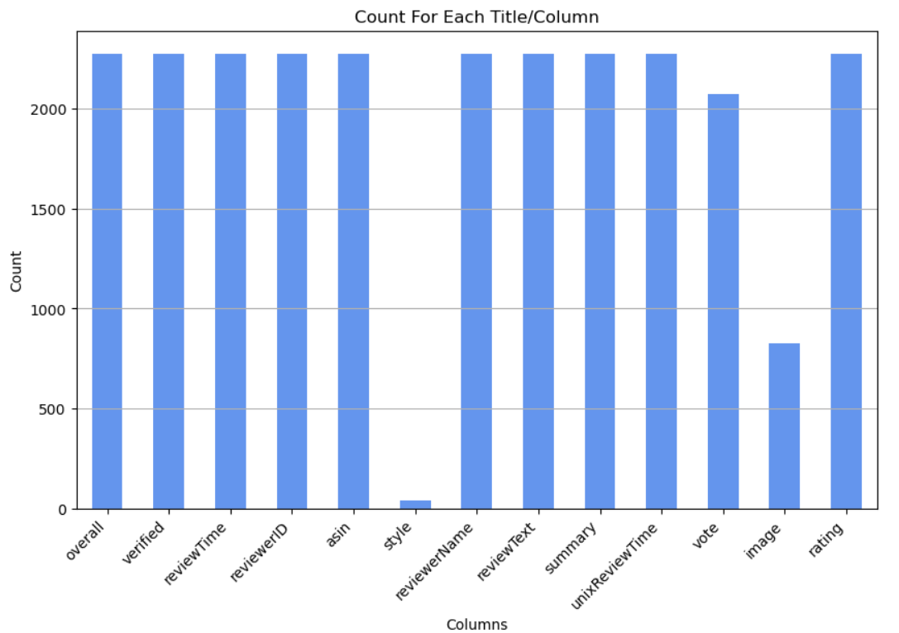
Count for each column

Slide 4
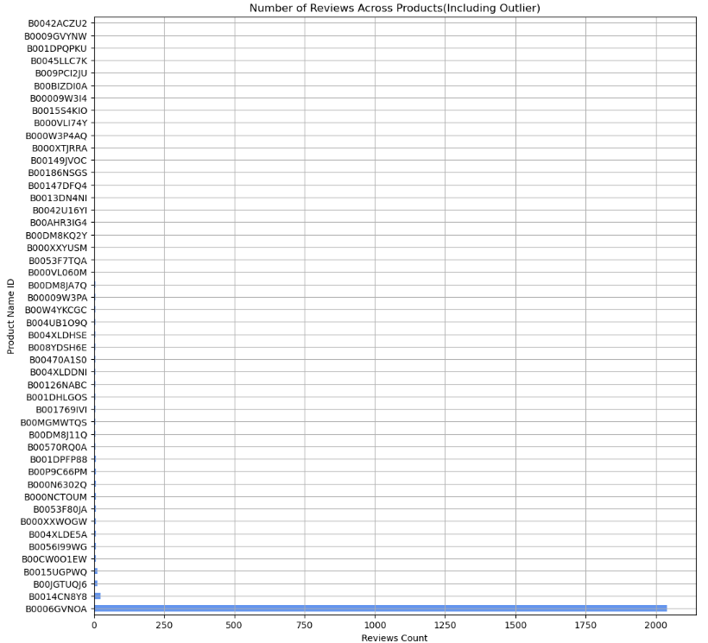
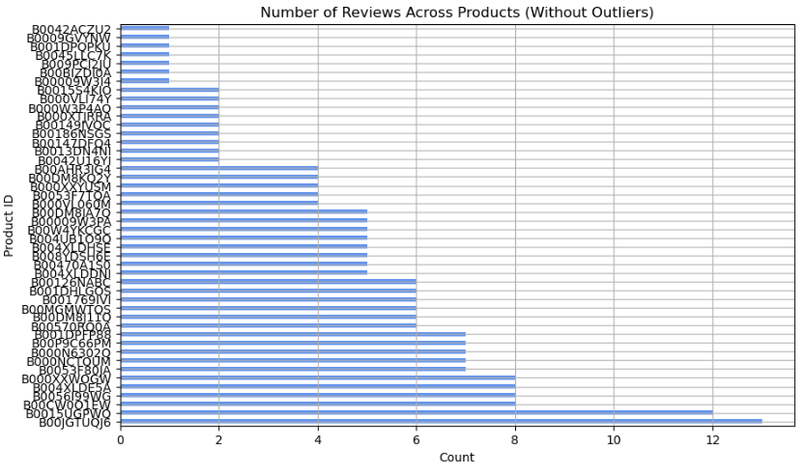
Product ID review(with outlier vs without)

Slide 5
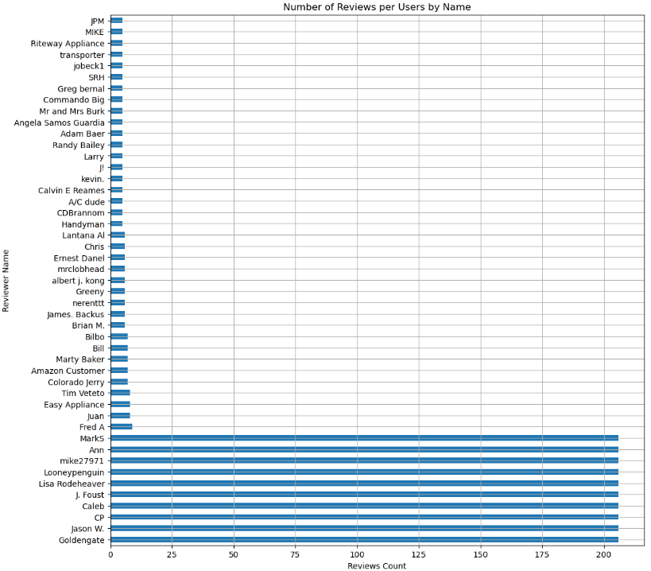
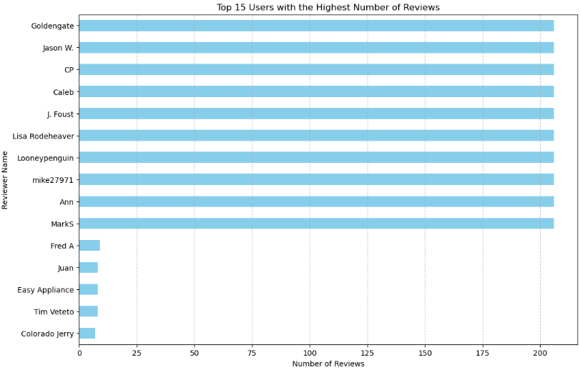
User review count

Slide 6

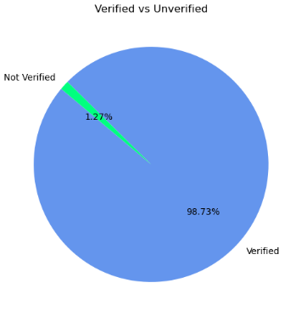
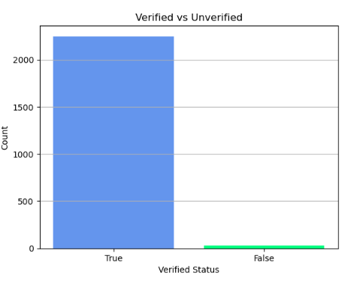
Number of verified products

Slide 7
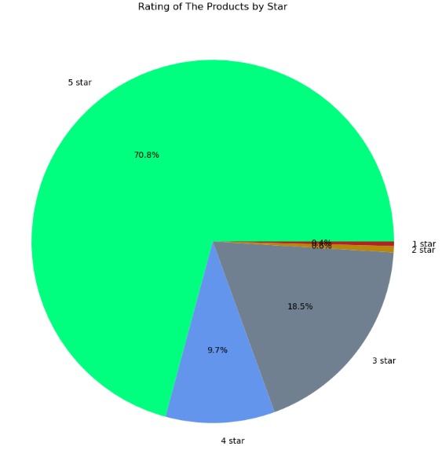
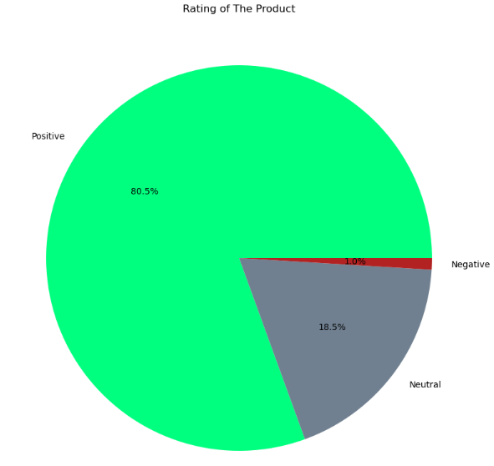
Rating of the product
Rating Breakdown
Positive=1834
Neutral = 421
Negative =22
Overall Breakdown
1 star =9
2 star = 13
3 star =222
4 star =421
5 star =1612

Slide 8
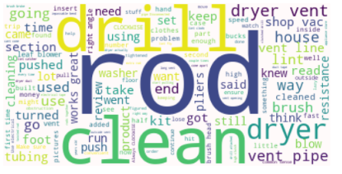
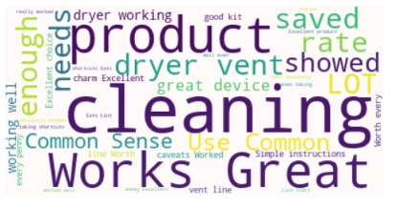
wordcloud
Reviewtext WordCloud
Summary Wordcloud

Slide 9
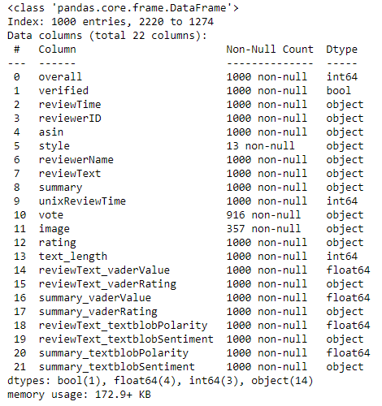
Original vs New Dataframe
Original Dataframe
New Dataframe

Slide 10
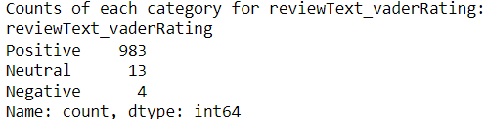
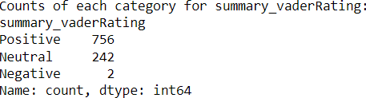
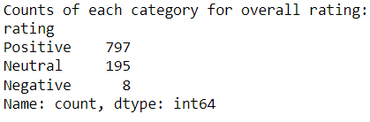
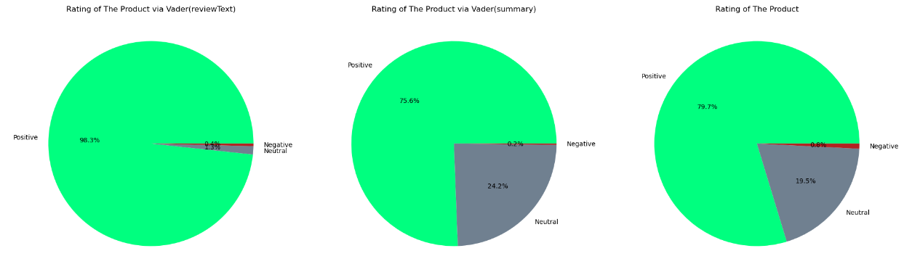
Vader Lexicon

Slide 11
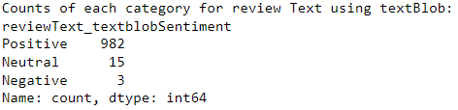
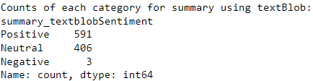
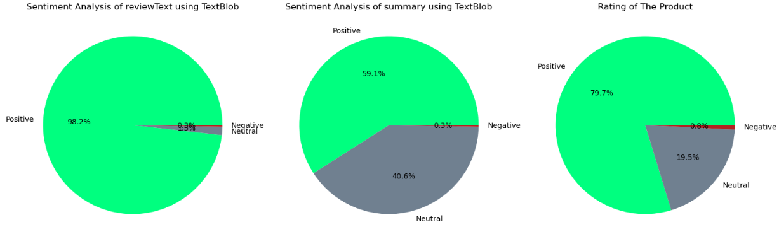
Textblob Lexicon

Slide 12
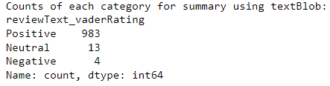
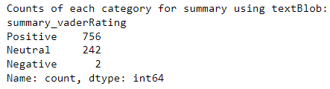
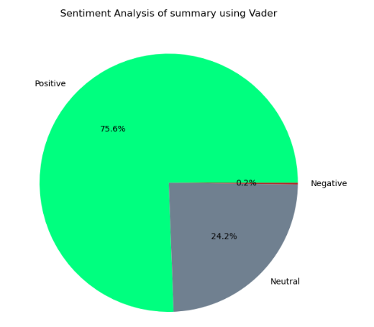
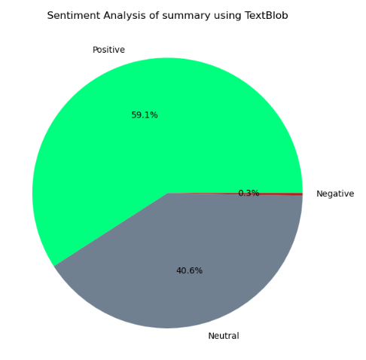
Vader vs TextBlob (Summary DataFrame)

Slide 13
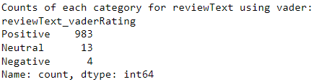
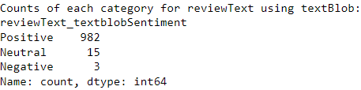
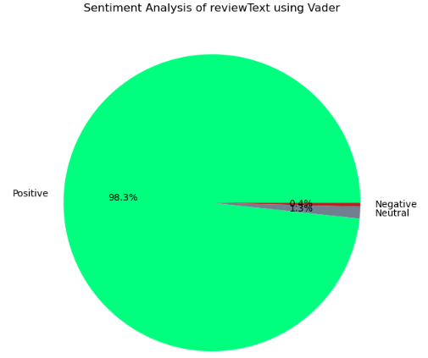
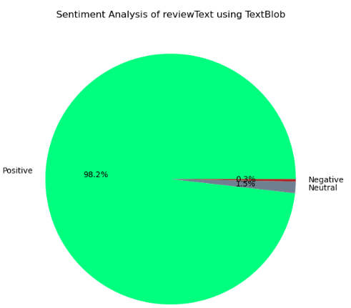
Vader vs TextBlob (Reviewtext DataFrame)

Slide 14
PHASE #2

Slide 15
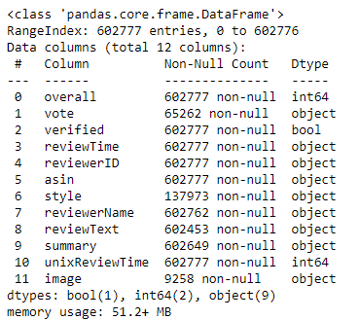
Dataset description
overall - Product Rating(int64)
verified - Product Verified(bool)
reviewTime - Time of the review(object)
reviewerID - ID of the reviewer(object)
asin- ID of the Product also known as Amazon Standard Identification Number(object)
style-style of the product(object)reviewer
Name- The name of the reviewer of the product(object)
reviewText- Review of the product(object)
summary- Summary of the review(object)
unixReviewTime-(int64 )vote - Votes if review is helpful or not (object)
image- Image from the user/reviewer(object)

Slide 16
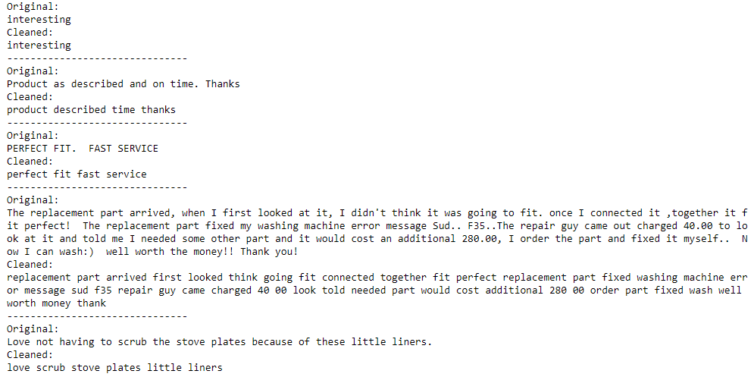
DatA Preprocessing
Preprocessing Used:
Tokenizer
Stopwords
String Manipulation
Notes:
Tokenizer-Tool that helps us break down a piece of text into smaller parts
Stopword-These words don't typically carry significant meaning on their own and are thus removed to focus on the more relevant content. Examples of stop words in English include "the," "is," "and," "but," "of," "in," etc.
Cleaning-.lower

Slide 17

Machine learning algorithm
SVM(Support Vector Machine)- A machine learning algorithm used for classification and regression tasks, aiming to find the optimal hyperplane that best separates different classes in the feature space.
Logistic Regression-is a statistical method used for binary classification tasks, predicting the probability of occurrence of an event by fitting data to a logistic curve.
Notes:
Support Vector Machine (SVM) is like drawing the best line or curve that helps us separate different groups of things as clearly as possible.
Logistic Regression is like making a guess based on some clues, but instead of just guessing "yes" or "no," it calculates the probability of something happening based on the information available.

Slide 18
SVM(Support Vector Machine)-
Pros
Cons
Effective in high-dimensional spaces.
Versatile
Works well with limited training data.
Robust against overfitting, especially in high-dimensional spaces.
Can handle large feature sets efficiently.
Sensitive to kernel parameters.
Computationally intensive for large datasets.
Model interpretation can be challenging.
Prone to overfitting with noisy data.
Ineffective for heavily overlapping classes.
Notes:
Pros
Works well even when dealing with a lot of different factors.
Can handle different types of data patterns, whether they're straight lines or more complex shapes.
Performs reliably even with a small amount of data.
Doesn't get easily fooled by irrelevant information, which can be a problem with other methods.
Efficiently handles situations where there are many different factors to consider.
Cons
SVM might not work well if we don't pick the right settings.
It can be slow when we have lots of data.
Sometimes it's hard to understand how it makes decisions.
If our data is messy, SVM might not perform well.
SVM might struggle if our groups overlap a lot.

Slide 19
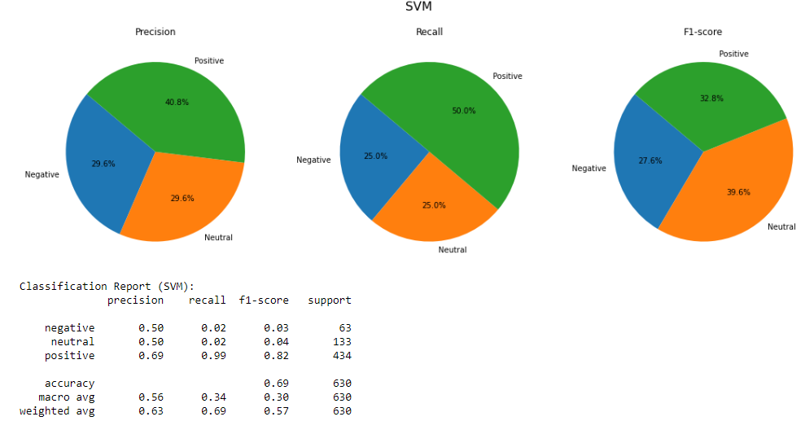
SVM Modelling

Slide 20
Logistic regression
Pros
Cons
Simple and easy to implement
It's highly interpretable and provides probabilities for outcomes.
Works well with linearly separable data.
Efficient for small dataset and doesn't require a large number of computational resources.
Less prone to overfitting compared to other complex models.
Assumes linear relationships between features and the target, which may not always be the case.
It's not suitable for complex data patterns or non-linear relationships.
Sensitive to outliers and multicollinearity.
Challenges with high-dimensional or categorical data.
Requires careful feature selection to avoid underfitting or overfitting.
Notes:
Pros
Logistic Regression is straightforward to understand and apply.
It gives understandable results, providing probabilities for predictions.
Works well when the relationship between features and target is linear.
Suitable for small datasets and doesn't need extensive computational resources.
Less likely to overfit, making it reliable for many real-world scenarios.
Cons
Assumes linear relationships, which may not reflect real-world complexity
Less effective for complex, non-linear data patterns
Sensitive to outliers and multicollinearity
Challenges with high-dimensional or categorical data
Requires careful feature selection to prevent underfitting or overfitting

Slide 21
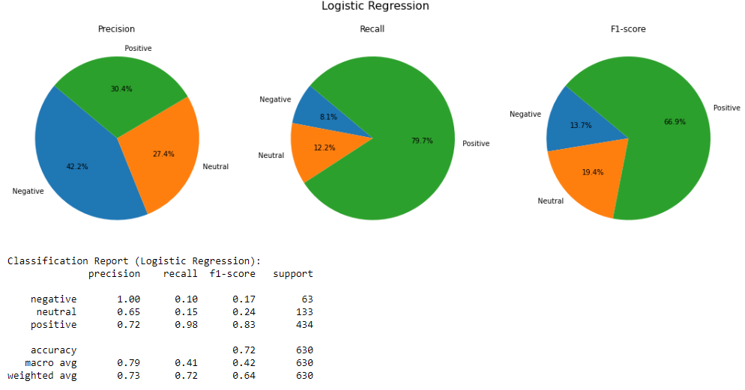
Logistic Regression Modelling

Slide 22
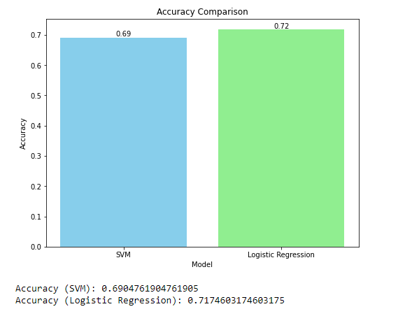
Accuracy comparison

Slide 23
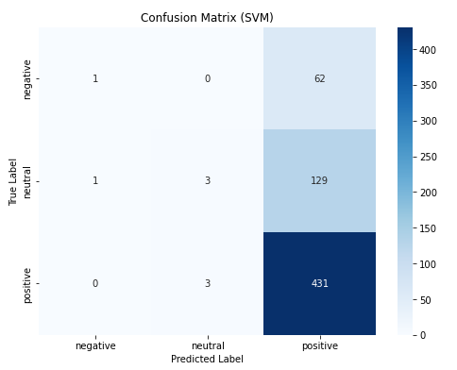
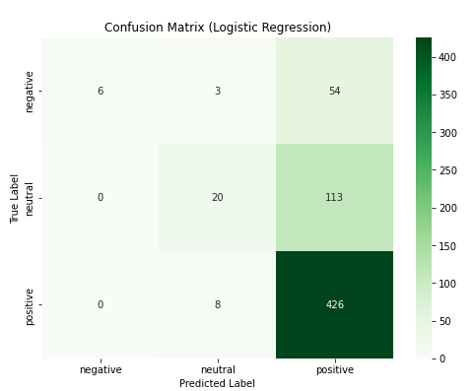
Confusion Matrix Comparison
Notes:
In the confusion matrix for SVM:
In the first row, the model correctly predicted 1 sample as negative, misclassifying 62 negative samples as positive.
In the second row, the model correctly predicted 3 neutral samples, misclassifying 1 neutral sample as negative and 129 neutral samples as positive.
In the third row, the model correctly predicted 431 positive samples, misclassifying 3 positive samples as neutral.
the colors in the matrix show how many predictions were made for each category. Darker colors, such as red, mean there were more predictions, while lighter colors, like green, mean there were fewer predictions. This helps us see which categories had more or fewer predictions at a glance.
In the confusion matrix for Logistic Regression:
In the first row, the model correctly predicted 6 negative samples, misclassifying 3 negative samples as neutral and 54 negative samples as positive.
In the second row, the model correctly predicted 20 neutral samples, misclassifying 113 neutral samples as positive.
In the third row, the model correctly predicted 426 positive samples, misclassifying 8 positive samples as neutral.
Summary:
Both models had challenges with false positive predictions, especially for neutral and negative classes.
SVM misclassified more negative and neutral samples compared to Logistic Regression.
Logistic Regression had a higher number of false positive predictions for negative and neutral classes compared to SVM.

Slide 24
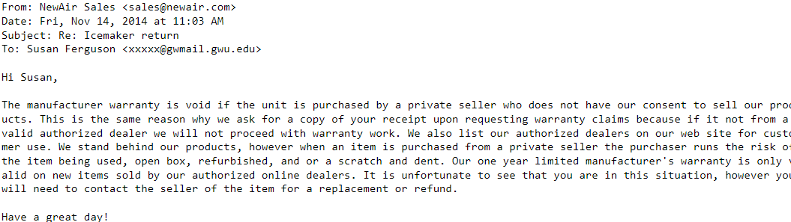
GPT-2
Review
Auto Generated Response

